Slide 1

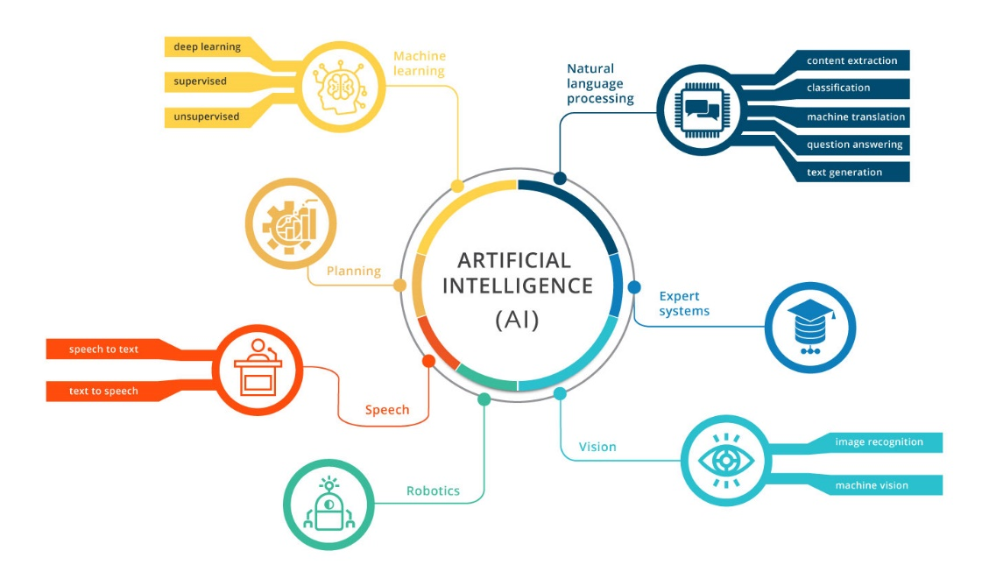
Data Science Use Cases in ERP

Slide 2
Agenda
What is ERP and Why we Need AI enabled ERP?
Different Modules of ERP
Module Wise Different Types of Use Cases
Phases of Adopting Artificial Intelligence based Services in ERP

Slide 3
Why Artificial Intelligence with ERP?
Enterprise resource planning (ERP) systems help organizations manage and connect daily business processes in various fields such as finance (financial analysis, procurement, accounting), operations (supply chain management and planning, inventory management) and human resource management (workforce planning and management).
AI-enabled ERP solutions help businesses streamline ERP processes with applications such as ML models and conversational AI systems.

Slide 4
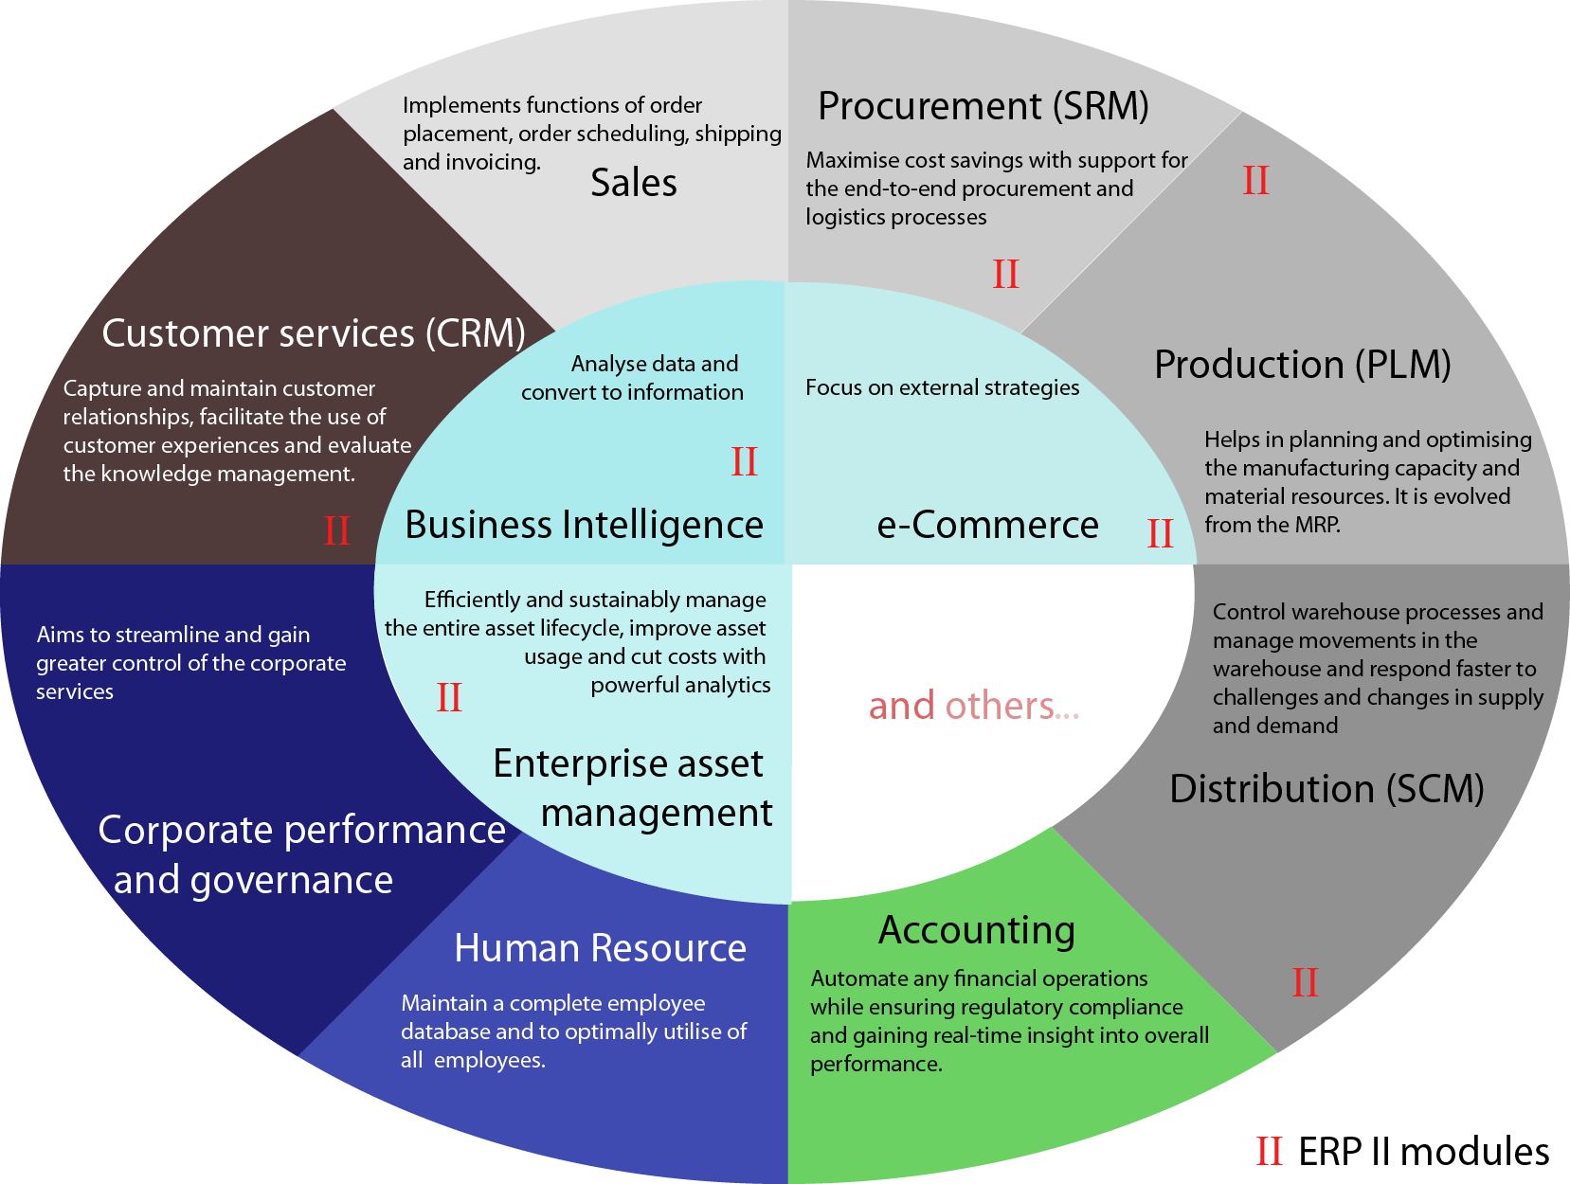
Enterprise Resource Planning

Slide 5
Data Science Use Cases in Sales
Demand/ Sales Forecasting (Region Wise Demand of DANA product such as light vehicle, Commercial Vehicle and Off-Highway)
Advance Analytics of Sales Teams (Optimization Process)
Customer Segmentation (Region Wise, Category Wise, Spending Behavior) for better Sales Strategies
Customers’ Churn Analysis (Customers’ Retention Efforts)
Opinion Mining for Potential Market

Slide 6
Demand/ Sales Forcasting using ML
ERP systems contain extensive data about sales. DS can help in finding trends that helps the company to understand and determine the timing of ordering more products or raw material and which offering will most likely sell in the next season.
Seasonality factors can be discovered that guides the key users in Inventory Management, for example. In manufacturing these advantages can be used to predict prices, determine amount of supplies to be purchased, manpower required, etc.
In DANA, forecasting of products of Light Vehicle (Passenger Car, Light Truck, SUV/CUV), Commercial Vehicle (Linehaul, Heavy-Haul, Medium-Duty, Vocational) and Off-Highway (Motors, Inverters, and On-Engine Generators, Systems Solutions, Axles and Drives, Transmissions and Electronic Controls, Driveshafts, Custom Gears and Shifting Solutions, Motion Systems)

Slide 7
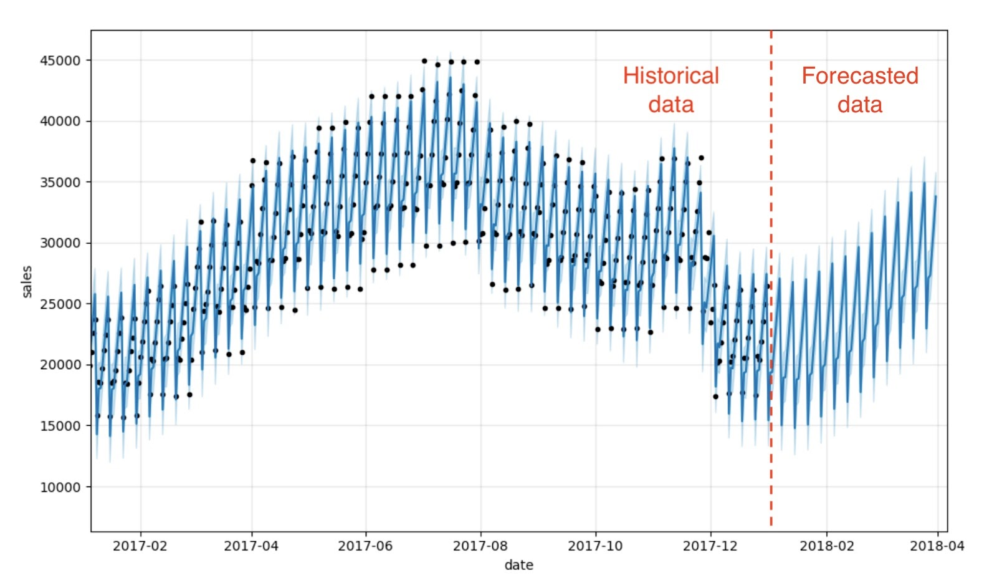
Demand/ Sales Forcasting using ML
Using Historical data of sales at DANA, we can easily predict/ Forecast the next demand/ sales using State of the Art Machine Learning Algorithms.

Slide 8
Demand/ Sales Forcasting using ML
Advanced Analytics & Forecasting
Most operations activities such as supply chain management and production can benefit from accurate predictions. AI models can improve predictions using historical data and current conditions. More specific applications exist in:
Production: Better managing seasonality to avoid underproduction or overproduction.
Warehouse Management: Better demand forecasting and being more prepared to supply chain disruptions.
Sales: More granular analysis of sales can provide better forecasts which translate to better targets, improving employee performance

Slide 9
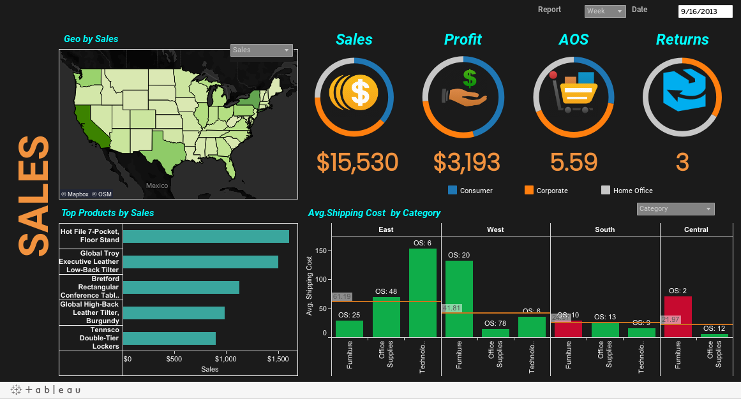
Data Science Use Cases in Sales
Continuous Improvement is necessary for survival of companies. An Advance Analytics system for Sales is important to get minute details of each and every happening in all regions of DANA
This will help decision makers to get centralized view of the company’s sales
This can help DANA to properly manage sales resources

Slide 10
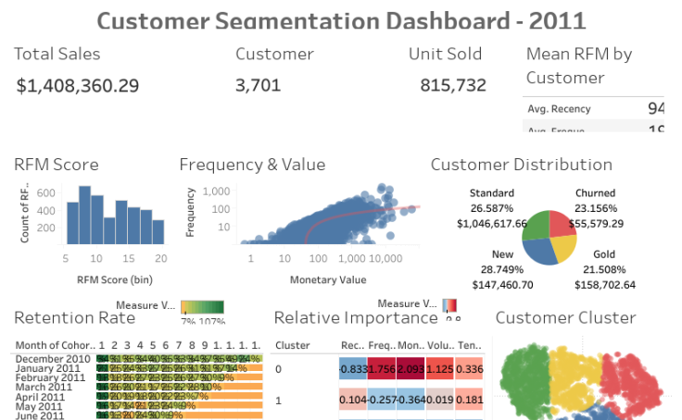
Customer Segmentation
For better Sales strategies, there is need of customer segmentation on the basis of regions, importance etc. This will help you to understand the requirements of each segment.

Slide 11

Customers Turnover/ Churn Prediction
It is always in an organization’s best interest to retain an existing customers/ employee rather than acquiring new customers/ employees
Data Science can help identify which DANA’s customers/ employees are more likely to stay a longer time within the organization by using Predictive Analysis (Machine Learning Algorithm)
It helps you identify who will leave, why, and what you can do about it. Analysis of past data, we can predict future event.

Slide 12
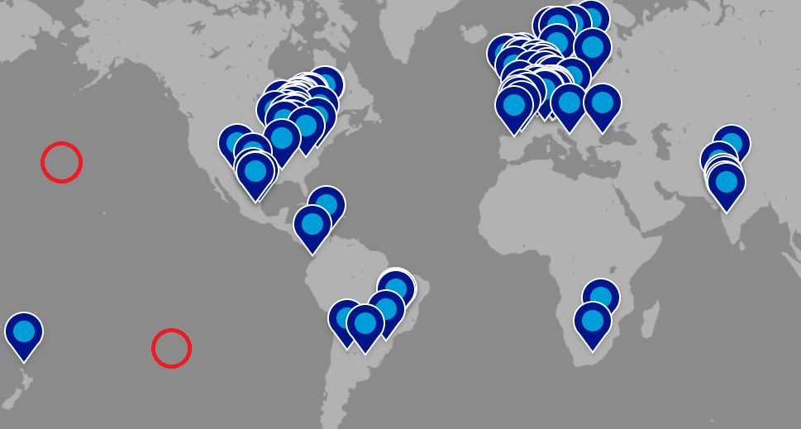
Opinion Mining for Potential Reach
It is very important to know about your potential market/ reach for your business.
This is only possible if you knew the people’s intention and opinion about your product
Analyzing social media for potential market of your product can be very effective to explore new opportunities

Slide 13
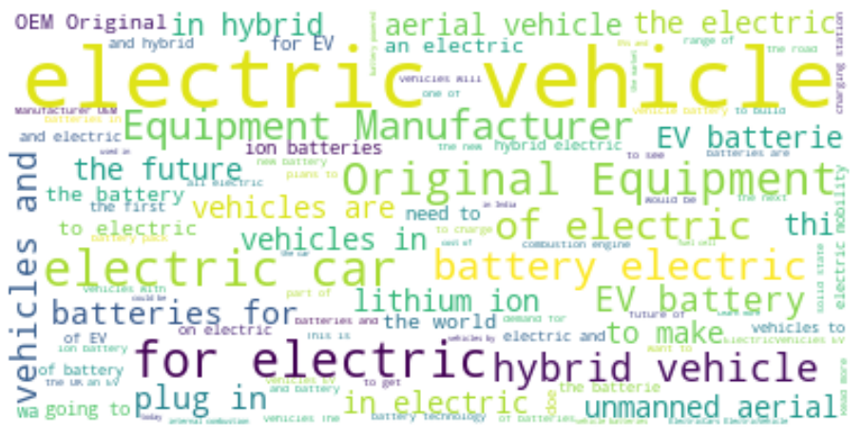
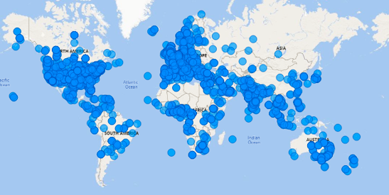
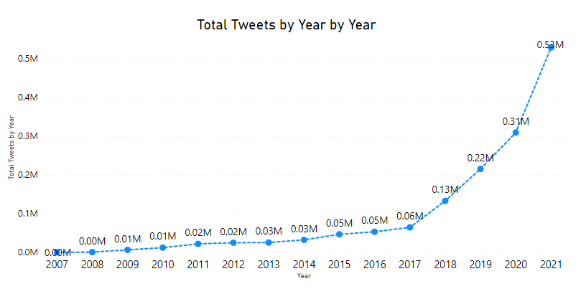
Opinion Mining for Potential Reach
On Twitter platform different Investors, Individuals, Companies and Researchers discussing about the Electric Vehicles
This topic is being discussed in these countries
Year Wise Trend of this topic can be seen increasing which shows the interest of Electric Vehicle in Different regions

Slide 14
Data Science Use Cases in HR
Talent Acquisition and Resume Filtering/ Screening
Reducing Employee Turnover/ Churn Prediction
Employees Career Dashboard/ Self Assessment Module
Sentiment Analysis of Customers/ Employees Reviews
SWOT Analysis Model
Workforce Analytics And Planning
Many Other Use Cases Depends on Data you have!!

Slide 15

Data Science Use Cases in HR
Which Data Science Use Case we can Deploy?
This mainly depends on
Data you have in your company
The Requirements
Which Employees are likely to left soon? (Prediction in advance, so that we made resources available to avoid issue?
Which Candidate should we select? Identify best possible resource as per our requirements?
As a Recruiter, how should I filter among 1000 resumes/ CVs quickly so that I save time and hire candidates ASAP.
My our employees/ Clients thinking about our products/ services? Review Analysis and Emails Analysis Quickly?
And much more exciting use cases.

Slide 16




Talent Acquisition and Resume Filtering/ Screening
Hundreds/ Thousands of people apply for job
When You Post Job
Difficult to Check all CVs/ Resumes, Time Consuming, may Miss best Candidates
Lets Solve This Problem

Slide 17




Talent Acquisition and Resume Filtering/ Screening
Multiple Resumes/ CVs
Company Defined Job Description
5 Years Exp, Manager etc
Artificial Intelligence System (NLP - TFIDF + Machine Learning)
Top 10 Most relevant CVS
Classify CVs Similar to JD
Not Applicable

Slide 18
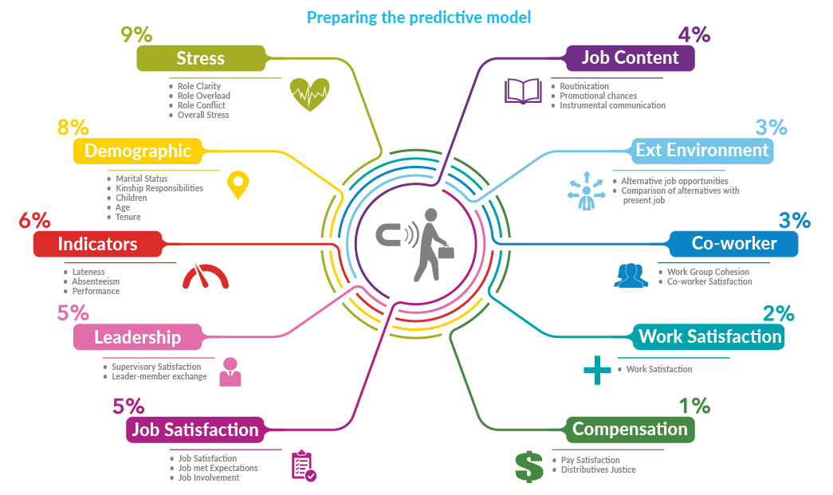
Reducing Employee Turnover/ Churn Prediction
Dana is composed of 40,000 employees across 31 countries.

Slide 19
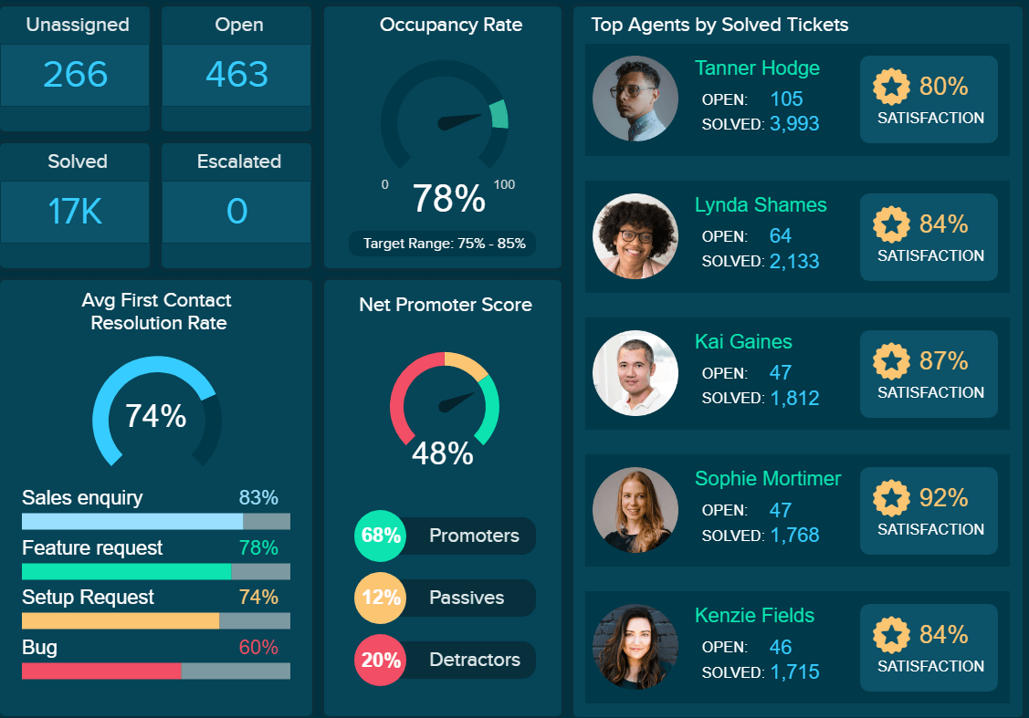
Advanced Operational Dashboards
Acquiring the right talent is just the first step to optimize business functions, the main challenge is the management of talent. We have learned that Data Science records employee performance, appraisals, compensation, behavior with regards to coworkers, upper management and HR, skillsets and experience, contribution made to the organization, how quickly they learn and apply a new skill. This information is analyzed, and insights are provided on how best to manage and retain them
The Solution is Detail Level Dashboard for HR

Slide 20
Employees Dashboard/ Self Assessment Module
Promotion, Salary Raise and other types of favors play an important role in employees life in a company
Employees often feel grievances over others’ promotion, or less salary raise this year etc. etc.
This can lead best employees to quit job and switch
The solution is Advance Analytics Dashboard, which will show following:-
Thier Current Performance in term of hours per day, projects completed per month, issues resolved per week etc.
The Career of employee in comparison with best employees
The possible steps (suggestions such as complete course, make 100% attendance etc) to improve employee score

Slide 21
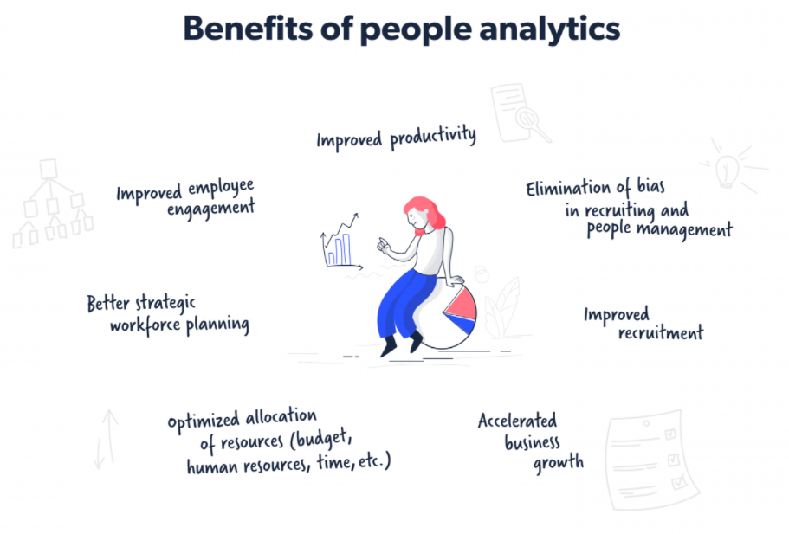
Other Possible Use Cases
Overall Analysis on HR related Data is helpful

Slide 22

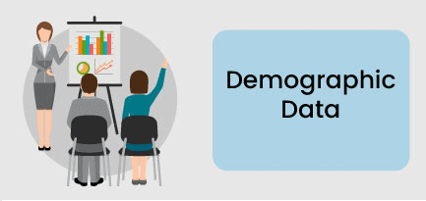


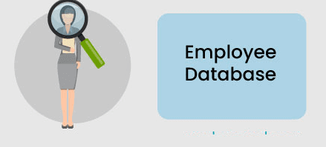
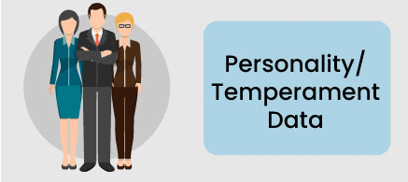


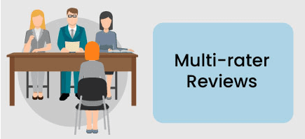
Data Sources

Slide 23
Data Science Use Cases for Customer Service
Interactive ChatBOT for Candidates Assistance
Sentiment Analysis of Customers Reviews
SWOT Analysis Model

Slide 24
Interactive ChatBOT for Customers Assistance
Asking Questions by Customers is an important aspect of any business
Assistance of your customers 24/7/365 helps you to retain customers for longer period
Solution is to deploy NLP Based AI ChatBOT

Slide 25



Interactive ChatBOT for Customers Assistance
DATA
Employee or
Candidate
Intelligent ChatBOT
Intent Detection
Sentiment Analysis

Slide 26
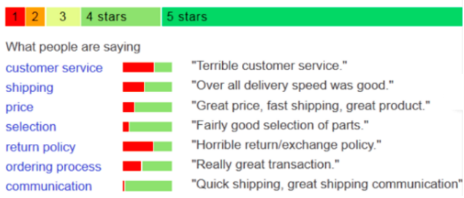
Analysis of Customers Reviews
Survey about the processes/ products/ services on weekly/ monthly basis is essential process in big companies
Evaluating those reviews is tedious task when you have hundreds of employees or thousands of Customers
You can leverage Machine Learning (NLP) to evaluate/ analyze reviews automatically and classify them as Positive, Neutral or Negative Reviews

Slide 27
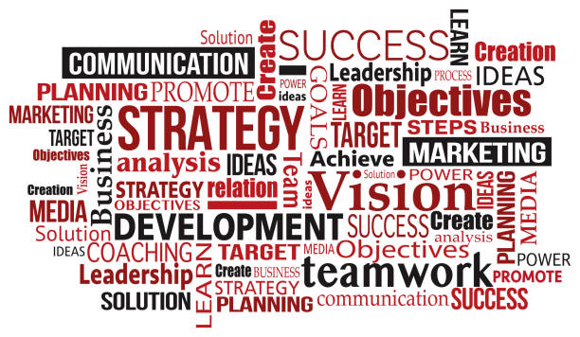
SWOT Analysis Model
Identifying Strength, Weaknesses, Opportunities and Threats is very important step for any company to survive
For that purpose there should be weekly or monthly reviews surveys/ questionnaires about current companies process and suggestions must be asked from customers in order to retain them (avoid churn)
The Problem is analyzing the response efficiently and quickly
We can develop an AI system which will use Natural Language Processing Tools to analyze automatically the key points

Slide 28
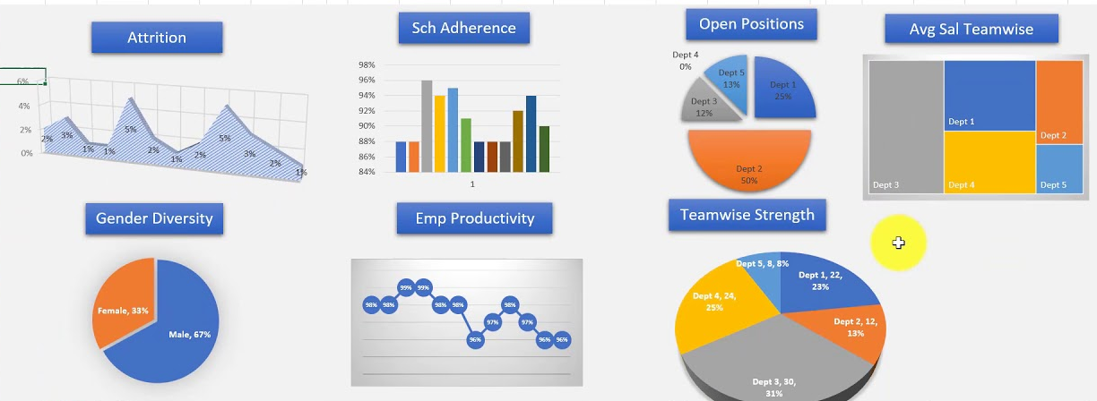
Workforce Analytics And Planning
This is another way of understanding the key needs of an organization. It deals with size, type, experience, knowledge and other such attributes that are important for enhancing the overall efficiency of an organization. This will help to maximize the throughput and ensure future business success.

Slide 29
Other Possible Use Cases
Project Hours Prediction
Using Past Data Train a Machine Learning that will predict the number of hours required to complete a project.
Project Team Members Prediction
Using Past Data Train a Machine Learning that will predict the number of people in a team required to complete a project.
Cost Management
In our experience, Data Science has helped tremendously in optimizing and controlling costs incurred to an organization. Analytics helps manage costs incurred during recruitment, onboarding, training and managing remuneration.
COMPENSATION & BENEFITS
In our experience, allowing employees to partake in the decisions regarding benefits such as Work from Home, insurance policies, holidays and sick leaves, and training services optimizes employee engagement. HR functions such as employee absenteeism, engagement and attrition can be monitored using HR Analytics function. Data science will help you identify key drivers that will retain and reward the right talent while boosting your organization’s bottom line.

Slide 30
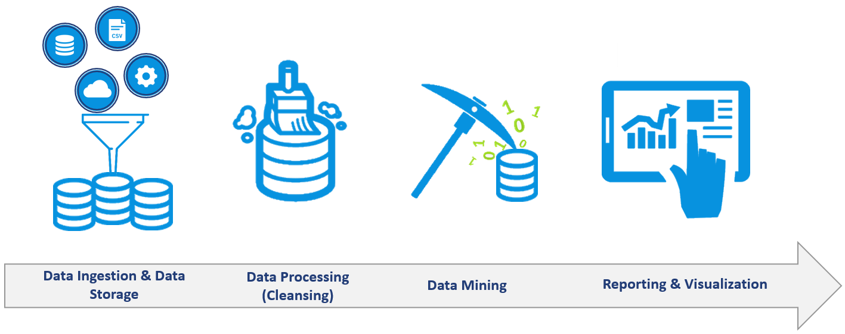
Technical Steps

Slide 31
Technical Steps
Data Collection from Multiple Sources
Data Pre-processing
Machine Learning Modeling
Models Deployment
End Users Systems
Dashboards for HR
Dashboards for Employees
AI Services/ Notifications etc.

Slide 32

Data Science Use Cases in HR

